Slide 1

Project Title - Seasonal Agriculture Performance Analysis
[Student Name – Siddh Jitendrabhai Patel
College Name- Krishna School of Emerging Technology & Applied Research (KPGU)]
AICTE STU ID : (STU6a6cb002979181785507842)

Slide 2

PROBLEM STATEMENT
Agricultural activities are influenced by seasonal variations in environmental conditions, farming practices, resource availability and market conditions. As a result, agricultural performance may differ from one season to another. However, raw agricultural data does not clearly explain how agricultural performance changes across seasons or what patterns can be observed in different seasonal conditions. The problem is to analyze the given agricultural dataset and investigate seasonal differences in agricultural performance by identifying meaningful patterns, trends, relationships and variations within the available data.

Slide 3
Project Description
Seasonal Agriculture Performance Analysis is a data analytics project focused on understanding agricultural activities across different seasons, geographical areas and farming conditions.
The project involves exploring and cleaning the agricultural dataset, comparing seasonal performance, identifying trends and relationships, examining resource usage and economic outcomes, and presenting evidence-based insights through statistical analysis and data visualization.

Slide 4

WHO ARE THE END USERS?
Farmers - understand seasonal changes and improve planning.
Agricultural planners - compare performance across seasons and regions.
Agricultural stakeholders - understand resource usage and seasonal outcomes.
Analysts / Researchers - identify trends, relationships and unusual patterns.
Decision makers - use data-driven insights for better seasonal agricultural planning.

Slide 5

Technology Used
Python - data analysis and processing
Google colab - documenting the complete analysis
Pandas - data cleaning and manipulation
NumPy - numerical analysis
Matplotlib/Seaborn - data visualization
Statistical analysis - identifying seasonal differences, trends

Slide 6
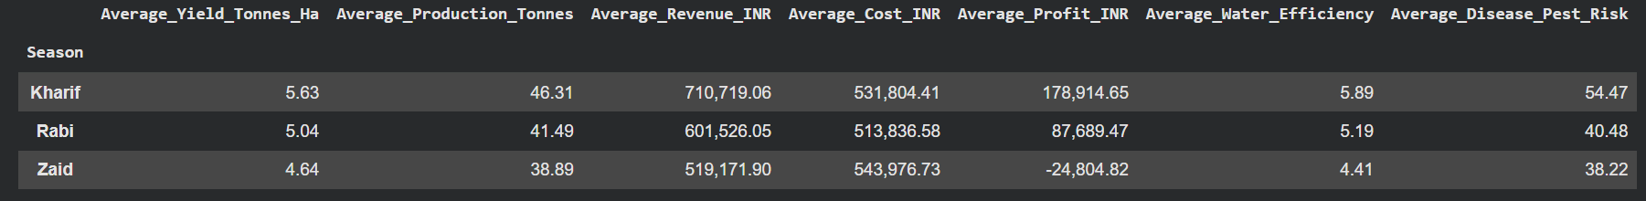
RESULTS
We compare the main performance indicators:
Yield
Production
Revenue
Cost
Profit
Water efficiency
Disease/pest risk

Slide 7
RESULTS
A one-way ANOVA is used to test whether mean yield differs significantly among the seasons.
H0: Mean yield is the same across seasons.
H1: At least one season has a different mean yield.
Significance level: 0.05

Slide 8
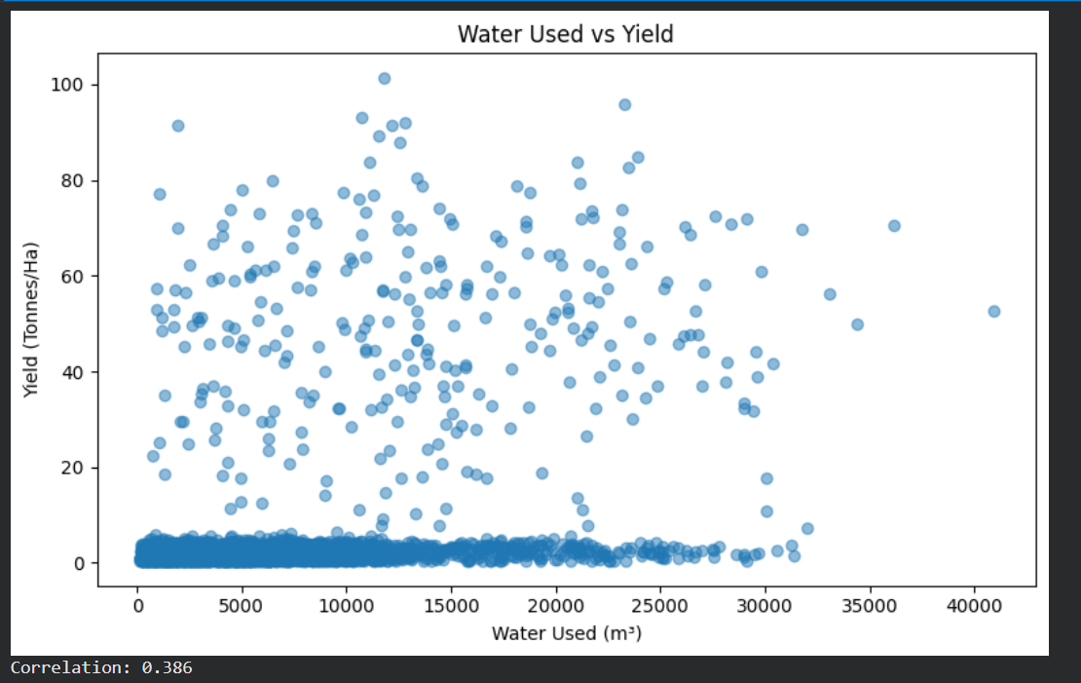
RESULTS
Water Usage and Yield Relationship in scatter plot

Slide 9
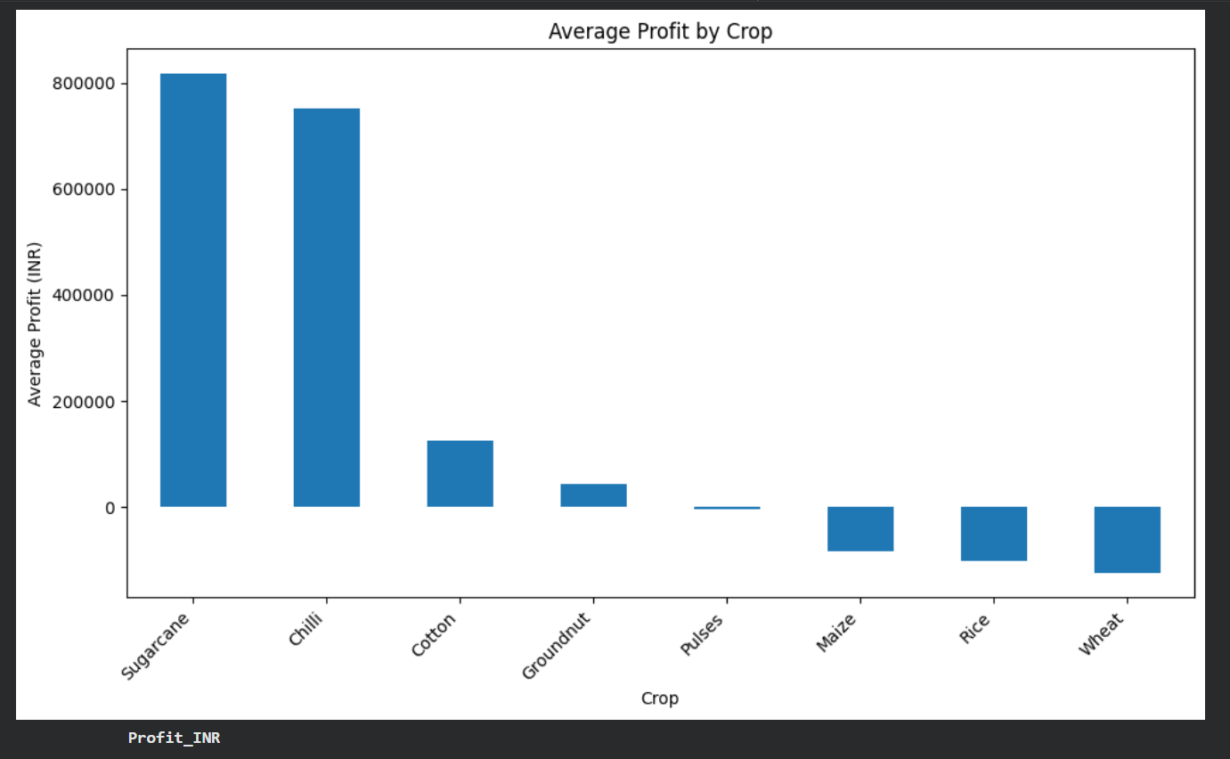
RESULTS
Crop-wise Average Profit in Bar Graph

Slide 10
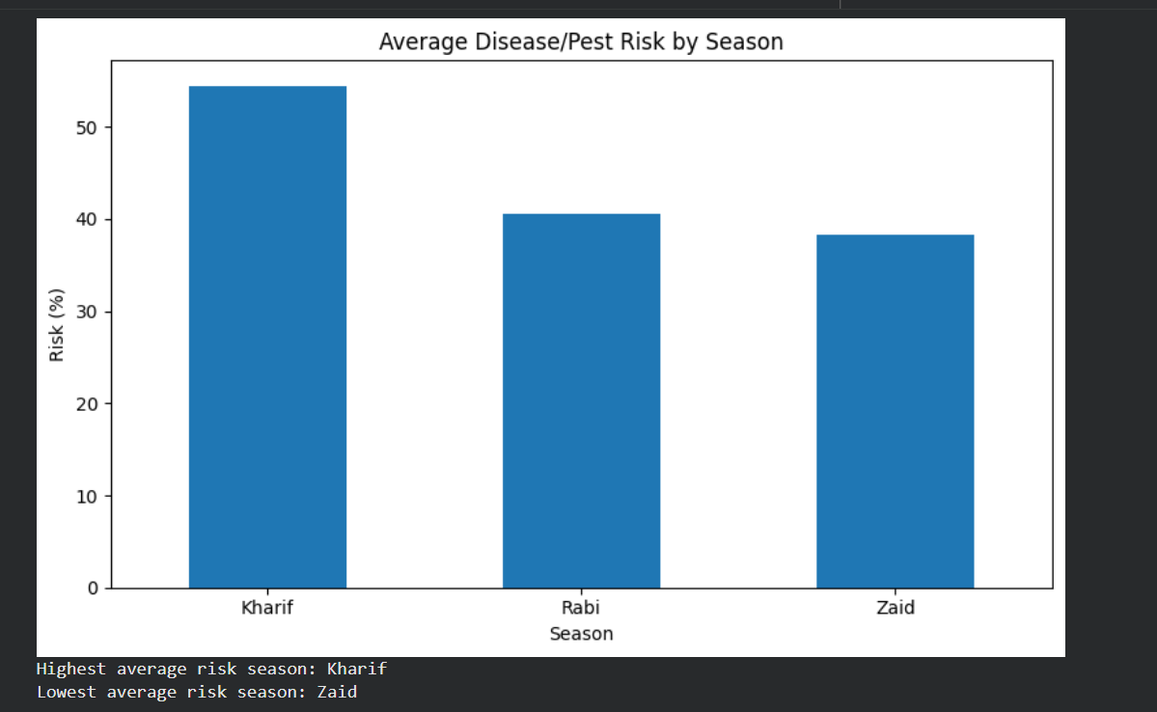
RESULTS
Disease and Pest Risk by Season in Bar Graph

Slide 11
Future scope
Extend the analysis with larger and more diverse agricultural datasets.
Build predictive models for seasonal agricultural performance.
Add real-time weather and environmental data.
Develop interactive dashboards for farmers and planners.
Compare additional regions, crops and farming categories.
Add automated alerts for unusual seasonal patterns.
Use findings to support improved seasonal resource planning

Slide 12
GitHub Link

Slide 13
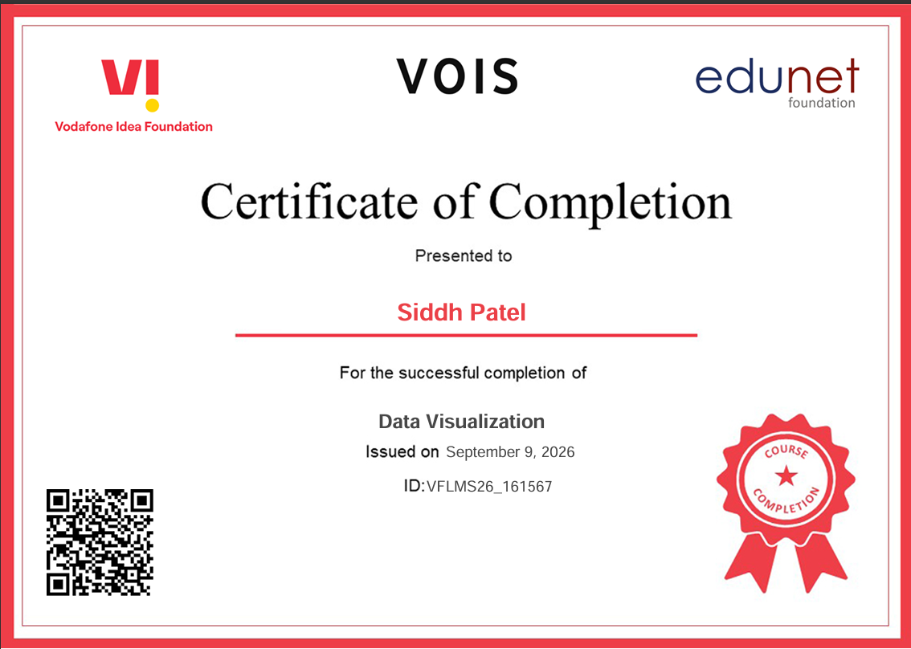
VOIS Course completion certificate - Course name- Data Visualization

Slide 14
Thank you
.
.

